Slide 1
CSI ZG515/ SS ZG515 Data Warehousing
Swarna Chaudhary
Assistant Prof.

Slide 2

The slides presented here are obtained from the authors of the books and from various other contributors. I hereby acknowledge all the contributors for their material and inputs.
I have added and modified a few slides to suit the requirements of the course.

Slide 3
Session 4
Extraction, Transformation & Loading (ETL)
Swarna Chaudhary
(swarna.chaudhary@pilani.bits-pilani.ac.in)

Slide 4
Outline
Introduction to ETL
Methods of applying data to the warehouse
Why data requires pre-processing?
Major types of transformations

Slide 5
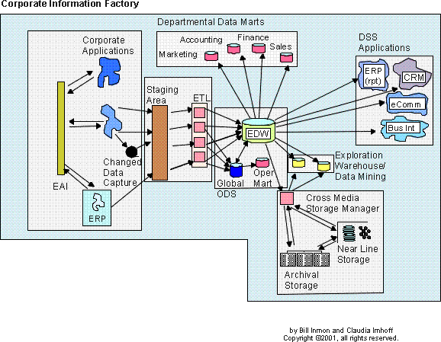
ETL
ETL i.e. Extract Transform and Load is the 3-step process wherein, data is taken (extracted) from the multiple sources, converted (transformed) into a format that can be analyzed, and stored into a data warehouse, and loading (Loaded) this transformed data to Data Warehouse.

Slide 6
ETL Tools
70% of the DW/BI effort is ETL.
In the past developers used to program.
ETL tooling is a popular choice today.
All the DBMS vendors offer tools.
Products
Informatica DI
IBM DataStage
Oracle Data Integrator
SAP Data Services
Microsoft SSIS

Slide 7
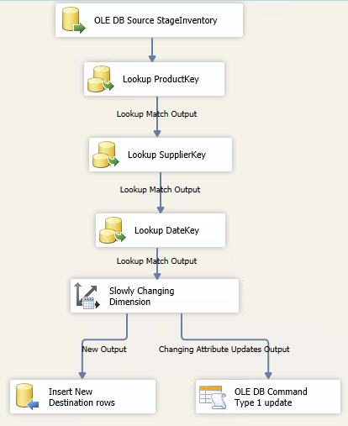
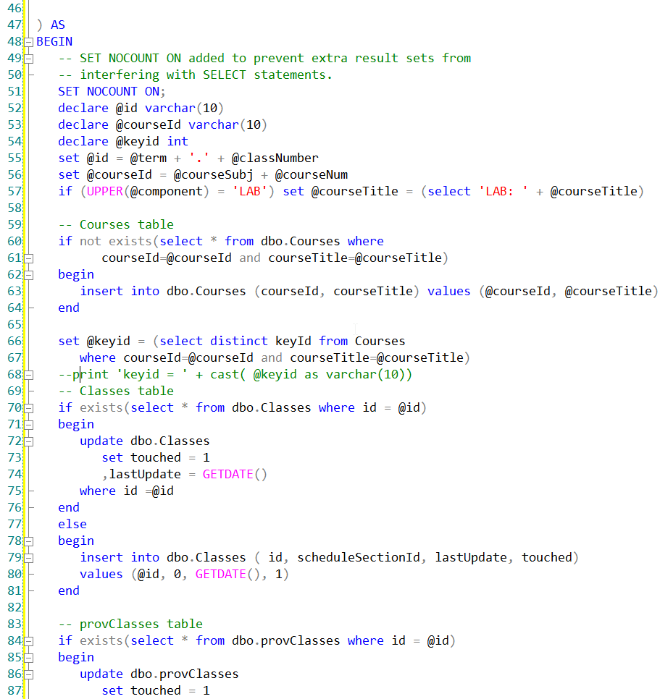
ETL Tool vs. Custom Coding
Which of these is easier to understand?

Slide 8
Kimball: 4 major
Extract the data from its source
Cleanse and Conform to improve data accuracy and quality (transform)
Deliver the data into the presentation server (load)
Managing the ETL process itself.
https://www.kimballgroup.com/2007/10/subsystems-of-etl-revisited/

Slide 9
EXTRACTING: GETTING DATA INTO THE DATA WAREHOUSE (“E” in ETL)
The extract-related ETL subsystems include:
Data Profiling (subsystem 1): Helps you to understand the source data
Collecting descriptive statistics like min, max, count and sum.
Collecting data types, length and recurring patterns.
Performing data quality assessment, risk of performing joins on the data.
Discovering metadata and assessing its accuracy.
Identifying distributions, key candidates, foreign-key candidates, functional dependencies, embedded value dependencies, and performing inter-table analysis.
Change Data Capture (subsystem 2)
Extract System (subsystem 3)

Slide 10
CLEANING AND CONFORMING DATA “T” in ETL
The five major subsystems in the cleaning and conforming step include:
Data Cleansing System (subsystem 4)
Error Event Tracking (subsystem 5)
Audit Dimension Creation (subsystem 6)
Deduplication (subsystem 7)
Data Conformance (subsystem 8): Responsible for creating conformed dimensions and facts

Slide 11
DELIVERING: PREPARE FOR PRESENTATION (“L” in ETL)
The delivery systems in the ETL architecture consist of:
Slowly Changing Dimension (SCD) Manager (subsystem 9)
Surrogate Key Generator (subsystem 10)
Hierarchy Manager (subsystem 11)
Special Dimensions Manager (subsystem 12)
Fact Table Builders (subsystem 13)
Surrogate Key Pipeline (subsystem 14)
Multi-Valued Bridge Table Builder (subsystem 15)
Late Arriving Data Handler (subsystem 16)
Dimension Manager (subsystem 17)
Fact Table Provider (subsystem 18
Aggregate Builder (subsystem 19)
OLAP Cube Builder (subsystem 20)
Data Propagation Manager (subsystem 21): Prepares conformed, integrated data from the data warehouse presentation server for delivery to other environments for special purposes.

Slide 12
ETL Management System
ETL Management System ensures:
Reliability
Availability of Data
Manageability

Slide 13
ETL Management SubSystems
ETL Management Sub-Systems are:
Job Scheduler (subsystem 22)
Backup System (subsystem 23)
Recovery and Restart (subsystem 24)
Version Control (subsystem 25)
Version Migration (subsystem 26): Migrates a complete version of the ETL pipeline from development into test and finally into production.
Workflow Monitor (subsystem 27)
Sorting (subsystem 28)
Lineage and Dependency (subsystem 29): Identifies the source of a data element and all intermediate locations and transformations for that data element
Problem Escalation (subsystem 30)
Paralleling and Pipelining (subsystem 31)
Security (subsystem 32)
Compliance Manager (subsystem 33)
Metadata Repository (subsystem 34)

Slide 14
Extract, Transform, Load (ETL)
Extract only relevant data from the internal source systems or external systems, instead of dumping all data (“data junkhouse”)
The ETL completion can take up to ~70% of your total effort while developing a data warehouse.

Slide 15
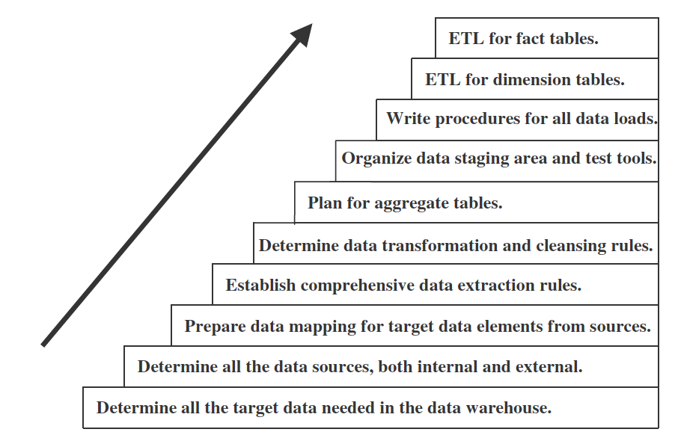
Major steps in ETL
Source: Paulraj Pooniah, Data Warehousing: Fundamentals for IT Professionals, 2ed

Slide 16
Challenges in ETL
Source systems are heterogenous on multiple platforms and different operating systems.
Historical data is generally not available in source operational systems, which is critical in a data warehouse.
Quality of data?
Source system structures keep changing over time because of new business conditions. ETL functions must also be modified accordingly.
Lack of consistency among source systems, For example, units of measurement, data on salary etc.
Data representation in different formats. i.e. Data is stored in different formats, different code conventions.

Slide 17
Data Extraction
Data can be extracted using third party tools or in-house programs or scripts
Data extraction issues:
Identify sources
Method of extraction for each source (manual, automated)
When and how much frequently data will be extracted for each source
Time window
Sequencing of extraction processes

Slide 18
How data is stored in operational systems
Current value: Values continue to changes as daily transactions are performed. The stored value of an attribute represents the current value. e.g., bank balance, customer address, etc.
Periodic status: maintains the history of data in the source system. The value of the attribute is preserved as the status every time a change occurs, with reference to time.

Slide 19
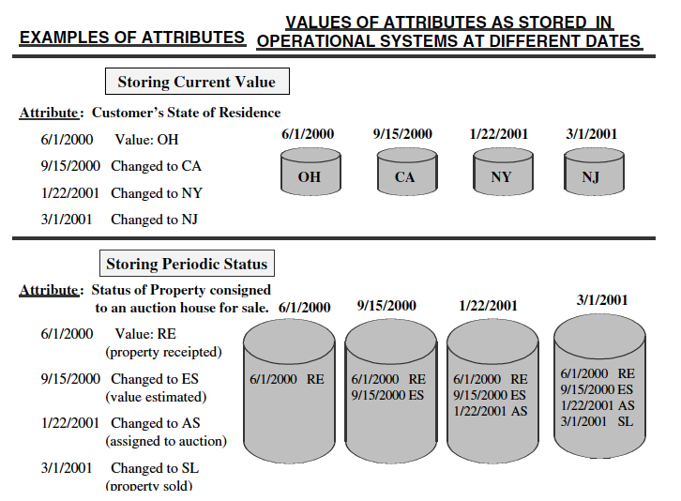
Example

Slide 20
Data Extraction Method
Static data extraction:
Extract the data at a certain time point.
It will include all transient data and periodic data along with its time/date status at the extraction time point
Used for initial data loading
Data of revisions aka Incremental data capture
Data is loaded in increments thus preserving history of both changing and periodic data
Incremental data capture can be either immediate or deferred.

Slide 21
Incremental data extraction
Immediate data extraction: involves data extraction in real time.
Possible options:
Capture through transactions logs
Make triggers/Stored procedures
Capture via source application

Slide 22
Deferred data extraction
Do not capture changes in real time.
Possible options:
Capture on the basis of time and date stamps
Capture by comparing files

Slide 23
Data Transformation
Major tasks:
Format conversions (change in data type, length)
Decoding of fields (1,0 → male, female)
Calculated and derived values (units sold, price, cost→ profit)
Splitting of single fields (House no 10, ABC Road, 54000, Lahore, Punjab, Pakistan)
Merging of information (information from different sources regarding any entity, attribute)
Character set conversion

Slide 24
Data Transformation (Cont.)
Conversion of unit of measures
Date/time conversion
Key restructuring
De-duplication
Entity identification
Multiple source problem

Slide 25
Data Loading
Determine when (time) and how (as a whole or in chunks) to load data
Four modes to load data
Load: removes old data if available otherwise load data
Append: The old data is not removed, the new data is appended with the old data
Destructive Merge: If primary key of the new record matched with the primary key of and old record then update old record
Constructive Merge: If primary key of the new record matched with the primary key of and old record then do not update old record just add the new record and mark it as superseding record

Slide 26
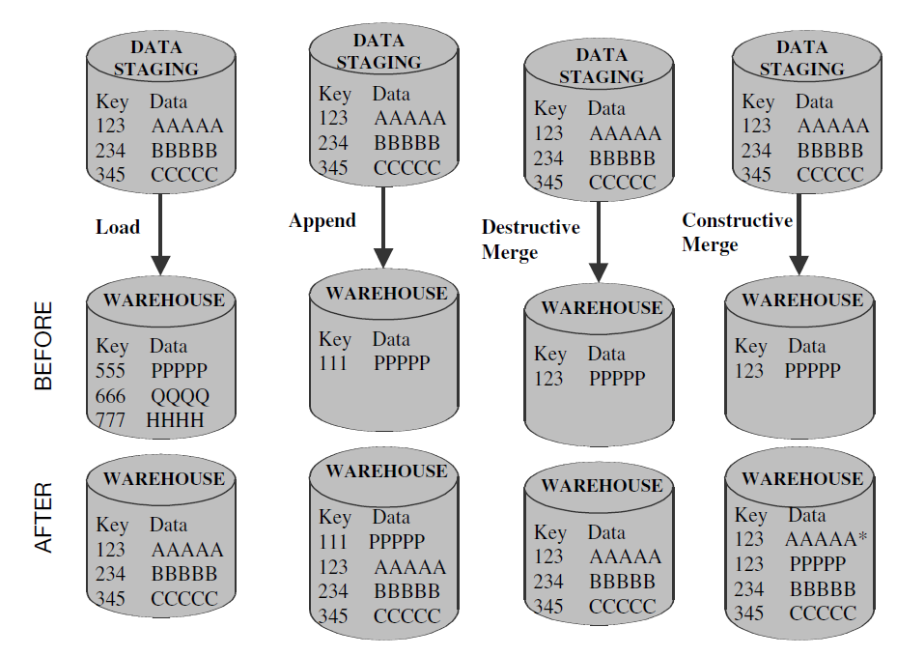
Data Loading

Slide 27
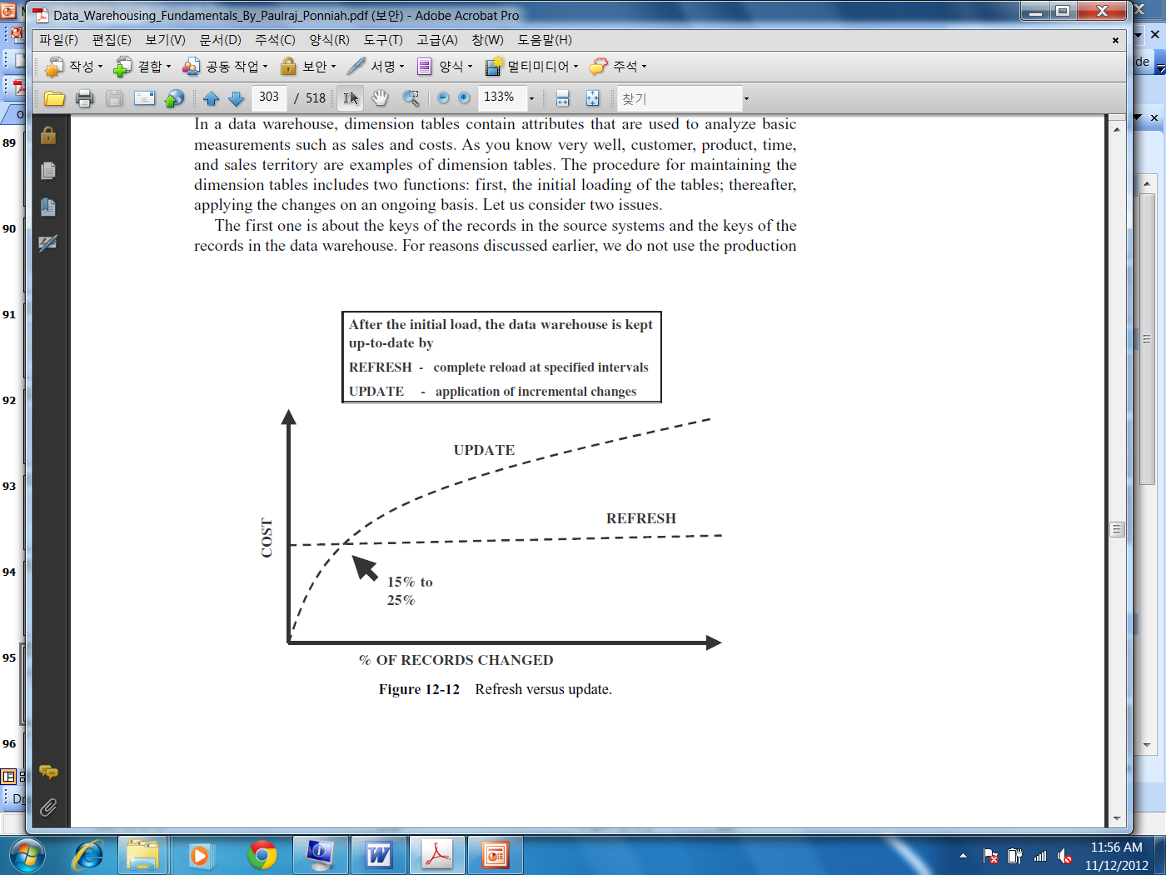
Data Loading (Cont.)
Data Refresh Vs. Data Update
Full refresh reloads whole data after deleting old data and data updates are used to update the changing attributes
The cost of refresh remains constant irrespective of the number of changes in the source systems. Whereas, the cost of update varies with the number of records to be updated.

Slide 28
Data Loading (Cont.)
Loading for dimensional tables: You need to define a mapping between source system key and system generated key in data warehouse, otherwise you will not be able to load/update data correctly

Slide 29
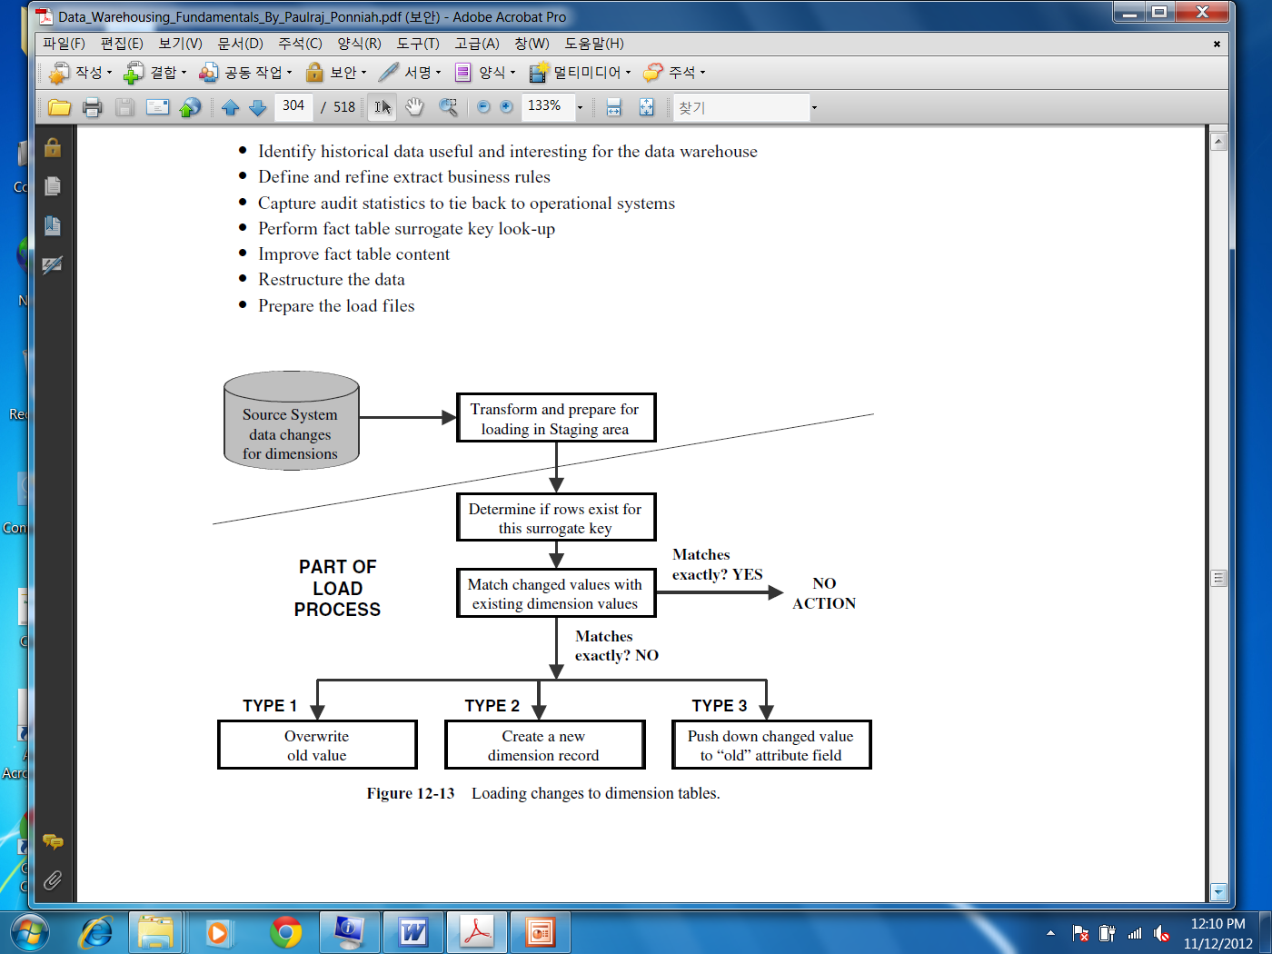
Data Loading (Cont.)
Updates to dimension table

Slide 30
Indicators of quality of data
Accuracy: Correct information, e.g., address of the customer is correct
Domain Integrity: Allowable values, e.g., male/female
Consistency: The content and its form is same across all source system, e.g., product code of a product ABC in one system is 1234 then in other system it must be 1234 for that particular product

Slide 31
Indicators of quality of data (Cont.)
Redundancy: Data is not redundant, if for some reason for example efficiency the data is redundant then it must be identified accordingly
Completeness: There are no missing values in any field
Conformance to Business rules: Values are according to the business constraints, e.g., loan issued cannot be negative
Well defined structure: Whenever the data item can be divided in components it must be stored in terms of components/well structure e.g. Address

Slide 32
Indicators of quality of data (Cont.)
Data Anomaly: Fields must contain that value for which it was created, e.g., State filed cannot take the city name
Proper Naming convention
Timely: timely data updates as required by user
Usefulness: The data elements in data warehouse must be useful and fulfill the requirements of the users otherwise data warehouse is not of any value
Interpretability: how easily the data can be understood

Slide 33
Indicators of quality of data (Cont.)
Entity and Referential Integrity: Entity integrity means every table must have a primary key and it must be unique and not null. Referential integrity enforces parent child relationship between tables, you can not insert a record in child table unless you have a corresponding record in parent table

Slide 34
Why do we need to preprocess the data?
Real-world data is generally noisy, incomplete, inaccurate data due to their typically huge size (often several gigabytes or more)
Since it is originated from multiple, heterogenous sources, hence inconsistent
Low-quality data leads to low-quality mining results.
“How can the data be preprocessed in order to help improve the quality of the data and, consequently, of the mining results?
How can the data be preprocessed so as to improve the efficiency and ease of the mining process?”
It is important to ensure that the data is correct to make right decisions
You need to put proper time and effort to ensure data quality

Slide 35
Data Preprocessing Tecniques
There are several data preprocessing techniques.
Data cleaning can be applied to remove noise and correct inconsistencies in data.
Data integration merges data from multiple sources into a coherent data store such as a data warehouse.
Data reduction can reduce data size by, for instance, aggregating, eliminating redundant features, or clustering.
Data transformations (e.g., normalization) may be applied, where data are scaled to fall within a smaller range like 0.0 to 1.0. This can improve the accuracy and efficiency of mining algorithms.

Slide 36
How to Handle Missing Data?
Ignore the tuple: usually done when class label is missing (when doing classification)
not very effective unless the tuple contains several attributes with missing values.
Fill in the missing value manually: tedious + infeasible?
Fill in it automatically with
a global constant : e.g., “unknown”, a new class?!
Use a measure of central tendency for the attribute
the attribute mean for all samples belonging to the same class
the most probable value: inference-based such as regression, Bayesian formula or decision tree induction.

Slide 37
Data Transformation
A function that maps the entire set of values of a given attribute to a new set of replacement values such that each old value can be identified with one of the new values
Methods
Smoothing: Remove noise from data
Attribute/feature construction
New attributes constructed from the given ones
Aggregation: Summarization, data cube construction
Normalization: Scaled to fall within a smaller, specified range
min-max normalization ,z-score normalization, normalization by decimal scaling
Discretization
Concept hierarchy generation

Slide 38
Data Smoothing techniques
Binning
Binning methods smooth a sorted data value by consulting its “neighbourhood”, i.e. the values around it.
first sort data and partition into (equal-frequency) bins
then one can smooth by bin means, smooth by bin median, smooth by bin boundaries (each bin value is replaced by the closest boundary value), etc.
Concept hierarchies can also be used for data smoothing
Regression
statistical process for estimating the relationships among variables.
Data smoothing can be done by regression, by fitting the data into regression functions.
“Linear Regression”: finding a function to fit 2 variables such as one variable is used to predict the value of other variable.
Multiple Regression: involves more than 2 variables.
Clustering
Similar values are organized into “clusters””
detect and remove outliers

Slide 39
Smoothing using Binning Methods
* Sorted data for price (in dollars): 4, 8, 9, 15, 21, 21, 24, 25, 26, 28, 29, 34
* Partition into (equi-depth) bins:
- Bin 1: 4, 8, 9, 15
- Bin 2: 21, 21, 24, 25
- Bin 3: 26, 28, 29, 34
* Smoothing by bin means:
- Bin 1: 9, 9, 9, 9
- Bin 2: 23, 23, 23, 23
- Bin 3: 29, 29, 29, 29
* Smoothing by bin boundaries: [4,15],[21,25],[26,34] : nearest boundary value
- Bin 1: 4, 4, 4, 15
- Bin 2: 21, 21, 25, 25
- Bin 3: 26, 26, 26, 34

Slide 40
Normalization
Min-max normalization: to [new_min_{A}, new_max_{A}]
Ex. Let income range $12,000 to $98,000 normalized to [0.0, 1.0]. Then $73,000 is mapped to
Z-score normalization (μ: mean, σ: standard deviation):
Ex. Let μ = 54,000, σ = 16,000. Then
Normalization by decimal scaling
Where j is the smallest integer such that Max(|ν’|) < 1

Slide 41
Discretization
Discretization: Divide the range of a continuous attribute into intervals
Interval labels can then be used to replace actual data values
Reduce data size by discretization
Discretization by Binning

Slide 42
Concept Hierarchy Generation
Concept hierarchy organizes concepts (i.e., attribute values) hierarchically and is usually associated with each dimension in a data warehouse
Concept hierarchies facilitate drilling and rolling in data warehouses to view data in multiple granularity
Concept hierarchy formation: Recursively reduce the data by collecting and replacing low level concepts (such as numeric values for age) by higher level concepts (such as youth, adult, or senior)
Concept hierarchies can be explicitly specified by domain experts and/or data warehouse designers
Concept hierarchy can be automatically formed for both numeric and nominal data. For numeric data, use discretization methods shown.

Slide 43
Concept Hierarchy Generation
Specification of a partial/total ordering of attributes explicitly at the schema level by users or experts
street < city < state < country
Specification of a hierarchy for a set of values by explicit data grouping
{Urbana, Champaign, Chicago} < Illinois
Specification of only a partial set of attributes
E.g., only street < city, not others
Automatic generation of hierarchies (or attribute levels) by the analysis of the number of distinct values
E.g., for a set of attributes: {street, city, state, country}

Slide 44
References:
Ponniah P, “Data Warehousing Fundamentals”, Wiley Student Edition, 2012
https://www.kimballgroup.com/data-warehouse-business-intelligence-resources/kimball-techniques/etl-architecture-34-subsystems/
Jiawei Han, Micheline Kamber and Jian Pei, “Data Mining: Concepts and Techniques”, Morgan Kaufmann Publishers 2012

Slide 45
Q & A

Slide 46
Thank You

